Slide 1

Amazon Web Services
workshop
for System Engineer
Using Amazon Elastic Load Balancing (ELB)

Slide 2
Topics
Understand of Amazon Elastic Load Balancing
Create

Slide 3
Objectives
You will be able to
Creating an Elastic Load Balancer
Adding Instances to an Elastic Load Balancer.
See how Amazon ELB distributes traffics from client to EC2 instances.

Slide 4

Amazon Elastic Load Balancer
An Amazon Elastic Load Balancer (Amazon ELB) is a service that automatically distributes incoming application traffic across multiple Amazon EC2 instances. It enables you to achieve even greater fault tolerance in your applications, seamlessly providing the amount of load balancing capacity needed in response to incoming application traffic.
Elastic Load Balancing detects unhealthy instances within a pool and automatically reroutes traffic to healthy instances until the unhealthy instances have been restored.
Customers can enable Elastic Load Balancing within a single Availability Zone or across multiple zones for even more consistent application performance. Elastic Load Balancing can also be used in an Amazon Virtual Private Cloud (“VPC”) to distribute traffic between application tiers.

Slide 5
Amazon Elastic Load Balancer
Detects health of Amazon EC2 instances to ensure, detect, and remove failing instances.
Dynamically grows and shrinks resources based on traffic.
Seamlessly integrates with Auto Scaling to add and remove instances based on scaling activities.
Supports load balancing of applications using HTTP, HTTPS, SSL, and TCP protocol.

Slide 6
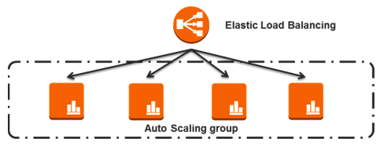
Amazon ELB & Auto Scaling Group
High Availability
Health Checks
Security Features
SSL Offloading
Strick Sessions
IPv6 Support
Layer 4 or Layer 7 Load Balancing
Operational Monitoring
Logging

Slide 7
AWS ELB: Pricing
You are charged for each hour or partial hour your Elastic Load Balancer is running and for each GB of data transferred through your Elastic Load Balancer.
For Asia Pacific (Singapore) Region
$0.028 per Elastic Load Balancer-hour (or partial hour)
$0.008 per GB of data processed by an Elastic Load Balancer
Partial hours are billed as full hours.
For example :- If the Elastic Load Balancer ended up transferring 100 GB of data over a 30 day period
The monthly charge would amount to $18 ($0.025 per hour x 24 hours per day x 30 days x 1 Elastic Load Balancer).
The data transferred through the Elastic Load Balancer would amount $0.80 ($0.008 x 100GB)
For a total monthly charge of $18.80.

Slide 8
Lab: Configure Amazon ELB
Overview
This guide introduces you to the Amazon Elastic Load Balancer using the AWS Management Console.
2 labs.
Topic Covered
Logging into the Amazon Management Console
Creating an Elastic Load Balancer
Adding Instances to an Elastic Load Balancer
POST messages into Node-RED to see how ELB works.
Note:
Do not delete ELB after finish this lab. It will be used in the next lab.

Slide 9
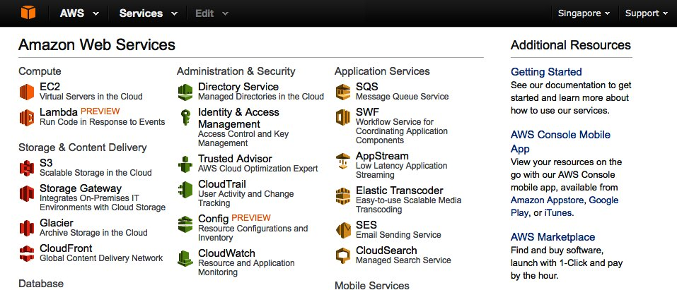
Lab 1-2: Login to AWS Console
Goto https://console.aws.amazon.com, enter AWS username and password and then click Login button.
In AWS Console, change Region to Singapore.
Click EC2 link under “Compute” group to open EC2 service console.
Click Load Balancers in the left pane, under Network & Security Group.

Slide 10
Lab 1-2: Create Amazon ELB
Open AWS EC2 Management Console.
Click Create Load Balancer button.
Step 1: For Load Balancer name, enter <yourname>-load-balancer.
Click Add button at the bottom-left of the dialog,
change Load Balancer Protocol to TCP
Load Balancer Port and Instance Port from 80 to 1880. Note: Node-RED used Web Socket in node design and it will not works with Amazon Elastic Load Balancer HTTP protocol.
Click Continue button.
Step 2: Change Pint Port from 80 to 1880.
Click Continue button.

Slide 11
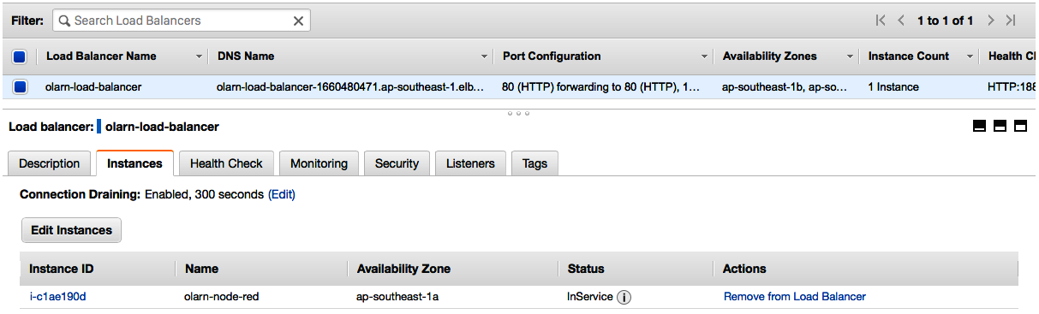
Lab 1-2: Create Amazon ELB
Step 3: Click Select an exist security group and choose <your_name>_nodered_sg (created in the EC2 lab).
Click Continue button.
Step 4: Choose your EC2 instance that running Node-RED (<your_name>_1 and <your_name>_2), click Continue button.
Step 5: Add 2 tags
Key = Name, Value = <your_name>_LB_instances.
Key = Group, Value = <your_name>_group.
Click Continue button.
Step 6: Click Create button, wait a few seconds and click Close button.
In the Load Balancer console. Click your Load balance configuration, click Instances tab below, you can see your EC2 instance status show as OutOfService. Wait a few minutes to let Load Balancer register to your EC2 until it changes to InService.

Slide 12
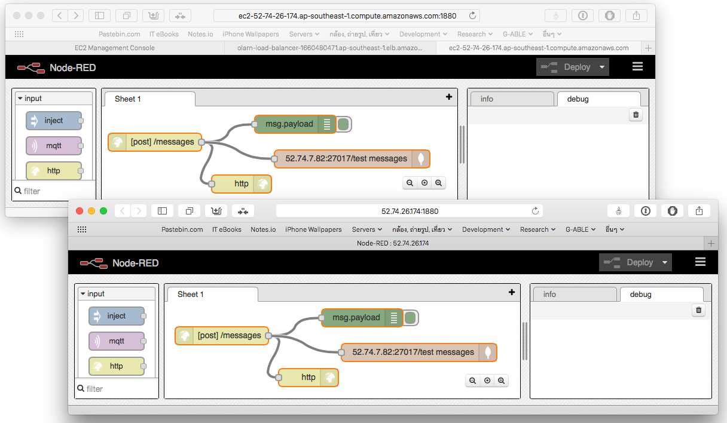
Lab 2-2: Test your Load Balancer
Open Description tab under your Load Balancer Configuration table in the AWS Load Balancer console.
Copy the Load Balancer’s DNS Name and paste it in your browser, follows with port 1880, for example http://<your_load_balancer_dns_name>:1880 Note: When you browse to Node-RED design screen with Load Balancer DNS name. It will open one of your EC2 instances. If you deploys any update to Node-RED, it will effects only the instance you are using, not the others.
Now, open Instances console by click the Instances link the the left pane, copy your EC2 DNS name (both of 2 EC2 instances) and open its in the browser.

Slide 13
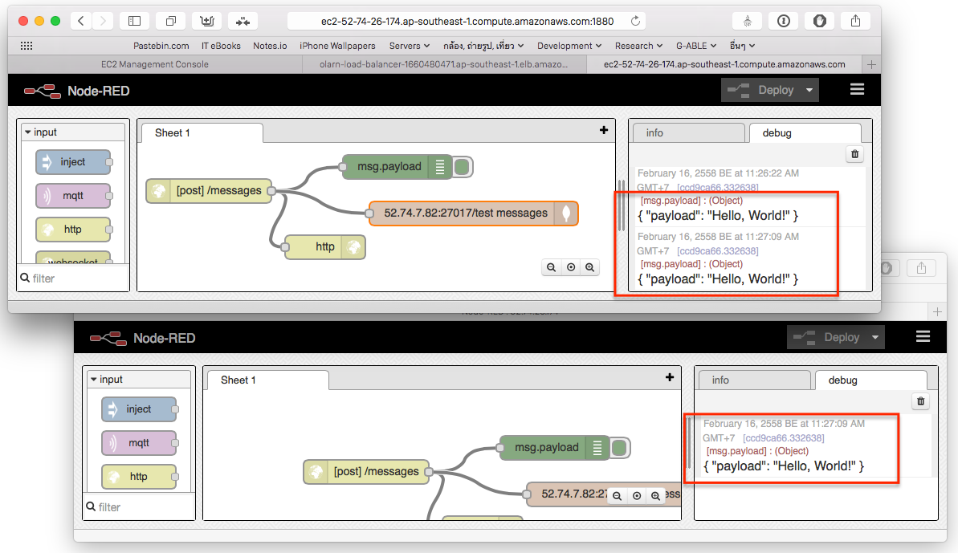
Lab 2-2: Test your Load Balancer
Open POSTER from Firefox, or Advanced REST Client from Chrome. Enter configuration as below
URL: http://<your_load_balancer_dns_name>:1880/messages
Content-type: application/json
Method: POST
Request Body: {“payload” : “hello world” }
POST the request, you should see the JSON document in the debug tab in Node-RED only one instance,
Try to POST another message with payload “hello world 2”. The message should be distributed to the second EC2 instance (see posted message in the debug tab).
Open SSH and remote to MongoDB EC2 instance, Both message should be saved in the database.

Slide 14
Conclusion
Congratulation! You’re finished this lab. In this lab, you:
Create a new Elastic Load Balancer using AWS Management Console.
Added Instances to an Elastic Load Balancer.
Test request distribution from client to EC2 instances behind Elastic Load Balancer.

Slide 15
References
Amazon Elastic Load Balancing http://aws.amazon.com/elasticloadbalancing/
Amazon ELB Pricing http://aws.amazon.com/elasticloadbalancing/pricing/

